Slide 1
INVESTMENT CASE STUDY SUBMISSION
Group Name:
Viswa Vivek Tupakula

Slide 2
Abstract
Spark Funds would like to explore new avenues of investment for company’s growth. As a part of investment, company would like to invest in the best sectors, countries, and a suitable investment type (venture, Angel, Private Equity and Seed). However for every round of investment the amount should be between 5 to 15 million USD.
While doing the analysis considered the fact that Spark Funds is more interested in investing in the countries where English is official language. To ease the communication with companies Spark Funds would invest.
The overall strategy is to invest where others are investing, implying that the 'best' sectors and countries are the ones 'where most investors are investing'.

Slide 3
Problem solving methodology
Start
Create D1, D2 and D3 frames for each country
Calculate total investment count wise and amount for main sector
Extract data from Companies, Rounds 2 and mapping file
Extract top 3 English Speaking countries
Map Primary Sector to Main Sector.
Extract top 3 sectors and top3 companies for the sector from D1, D2 and D3
Merge the files companies and round2 file as master_frame. And put mapping file in mapping data frame
Find the suitable Fund Type
Extract top 9 Countries
Split master_frame for primary sector
From mapping file replace 0 with ‘na ‘.
Chose the sector and Company of the sector which is more lucrative to investment
Is master frame?
NO
NO
YES
Is country Code Empty?
YES
Stop
Does file contains non-ASCII characters?
Remove rows with Blank countries
NO
YES
Remove NON-ASCII characters

Slide 4
Analysis
Companies File
The data was in tab separated text file.
Data contain non-readable character . The character needs to be removed .
Name, homepage_url , state_code ,region , city , and founded_at columns has missing data , however no impact on the analysis
category_list , and country_code have missing data as the missing data impacts the analysis we have preformed the necessary action after merging data with rounds2 data as master_frame
Rounds2 file:
Data contain non-readable character . The character needs to be removed .
Raised_amount_usd columns has blank values which impacts during averaging hence need to deal with the blank. we have preformed the necessary action after merging data with rounds2 data as master_frame.
Mapping File:
Certain data of Category_list column is corrupted i.e. 0 is present instead of letters, needs to replace it with ‘na’.
The data is in piviot format hence can be consumed directly.

Slide 5
Analysis

Slide 6
Analysis
Assumptions:
Unique count is taken before dealing blanks in both companies and rounds2 data frame
Master_frame total count is taken before dealing with blanks.
Removing all the rows where raised_Amount_usd is blank. Cant fill with mean/mode/median as the min and max difference is huge.
Removing all the rows where category_list if blank as we cant fill the data with category.
Removing rows where country_code is blank as filling the data is not possible, filling with highest occurrence of country is not appropriate.

Slide 7
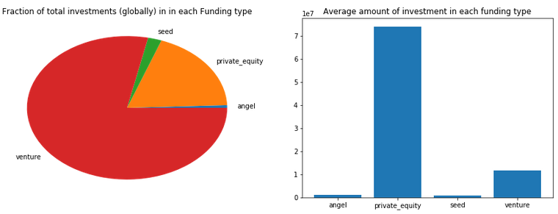
Results
Plot 1

Slide 8
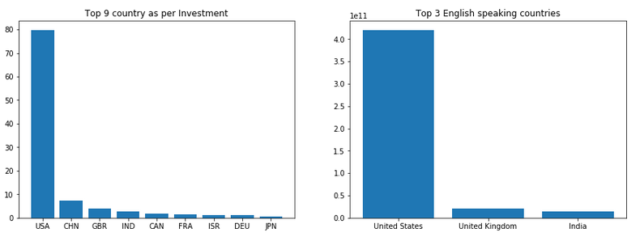
<Results>
Plot 2

Slide 9
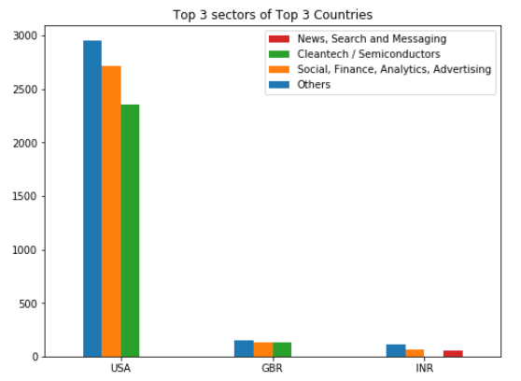
Results
Plot 3

Slide 10
Conclusions
Globally 60% of the investments is done on ventures. United state of America is Top1 country in which the investment is done highly on ventures in category others followed by “Social, Finance, Analytics, Advertising” and “Cleantech / Semiconductors ”.
After USA the following countries are United Kingdom and India for investment where English is official language.
We will recommend to go ahead with USA as most of the investment are done in the country . However, India is lucrative as the market is not saturated because the country is developing country.

